Slide 1

CUSTOMER RETENTION ANALYSIS
For Indian e-Commerce websites.

Slide 2
INTRODUCTION
Customer satisfaction has emerged as one of the most important factors that guarantee the success of online store; it has been posited as a key stimulant of purchase, repurchase intentions and customer loyalty. A comprehensive review of the literature, theories and models have been carried out to propose the models for customer activation and customer retention. Five major factors that contributed to the success of an e-commerce store have been identified as: service quality, system quality, information quality, trust and net benefit. The research furthermore investigated the factors that influence the online customers repeat purchase intention. The combination of both utilitarian value and hedonistic values are needed to affect the repeat purchase intention (loyalty) positively. The data is collected from the Indian online shoppers. Results indicate the e-retail success factors, which are very much critical for customer satisfaction.

Slide 3
contents :
Problem Statement
What is Customer Retention
Conceptual Background of the Domain Problem
Customer Retention benefits
Why retention is important: long term loyal customers
Problem understanding
Importing the necessary libraries and Collecting the data
Graphical Visualization
Limitations and scope for the future
Assumption
Conclusion
Limitations and Scope for the future

Slide 4
Problem statement :
Customer satisfaction has emerged as one of the most important factors that guarantee the success of online store; it has been posited as a key stimulant of purchase, repurchase intentions and customer loyalty. A comprehensive review of the literature, theories and models have been carried out to propose the models for customer activation and customer retention. Five major factors that contributed to the success of an e-commerce store have been identified as: service quality, system quality, information quality, trust and net benefit. The research furthermore investigated the factors that influence the online customers repeat purchase intention. The combination of both utilitarian value and hedonistic values are needed to affect the repeat purchase intention (loyalty) positively.

Slide 5
What is Customer Retention ?
Customer retention refers to the activities and actions companies and organizations take to reduce the number of customer defections.
The goal of customer retention programs is to help companies retain as many customers as possible, often through customer loyalty and brand loyalty initiatives.
Simply put, customer retention rate is the ability of a company to retain its customers over a given period of time.
It is important to remember that customer retention begins with the first contact a customer has with a company and continues throughout the entire lifetime of the relationship.

Slide 6
Conceptual Background of the Domain Problem
Customer satisfaction has emerged as one of the most important factors that guarantee the success of online store; it has been posited as a key stimulant of purchase, repurchase intentions and customer loyalty.
A comprehensive review of the literature, theories and models have been carried out to propose the models for customer activation and customer retention.

Slide 7
Customer Retention benefits :
Retention is Cheaper than Acquisition
Loyal Customers are More Profitable
You’ll Earn More Word of Mouth Referrals
Customers Will Explore Your Brand
Loyal Customers are More Forgiving
Customers Will Welcome Your Marketing
You Earn Wiggle Room to Try New Things

Slide 8
Why retention is important: long term loyal customers
Buy more per year
Buy higher priced options
Buy more often
Are less price sensitive
Are less costly to serve
Are more loyal
Have a higher lifetime value

Slide 9
Problem understanding :
Customer retention means the process of maintaining or keeping customers once you have acquired them. It’s all the activities that a company must do in order to keep their customers around.
The goal is to build a long-lasting relationship between the brand and consumers.
Once a customer becomes loyal to yo ur brand, not only he will buy more from you than a normal customer but he’ll spread good words about your business, increase your reputation.
Here we have to analyse the affect of different feature on customer retention.

Slide 10
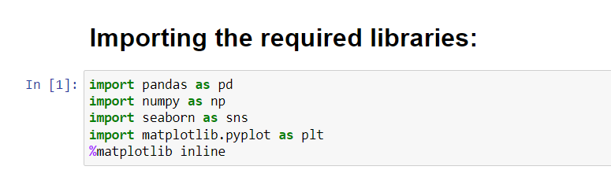
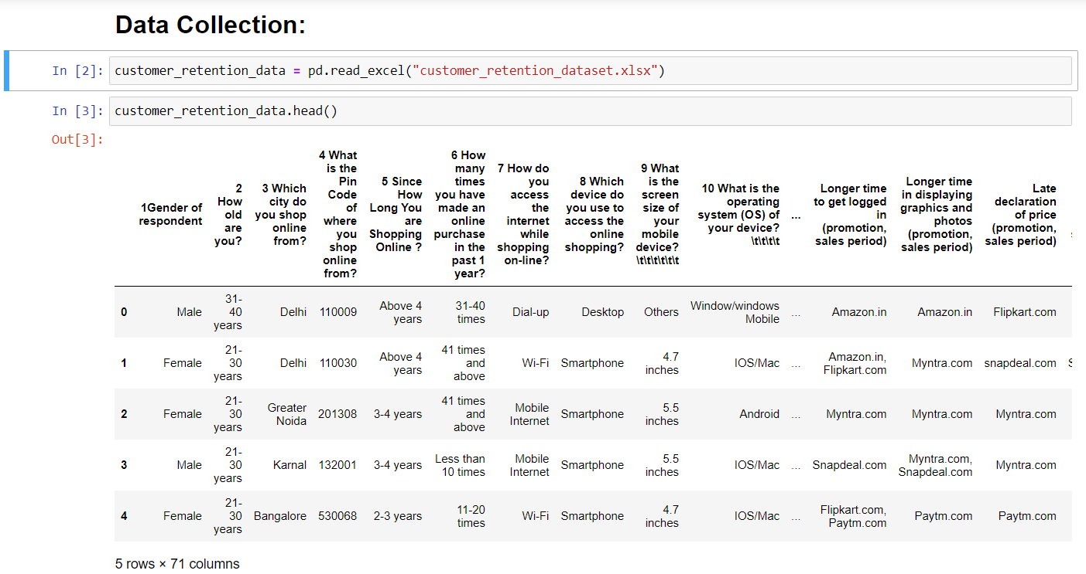
Importing the necessary libraries and Collecting the data :

Slide 11
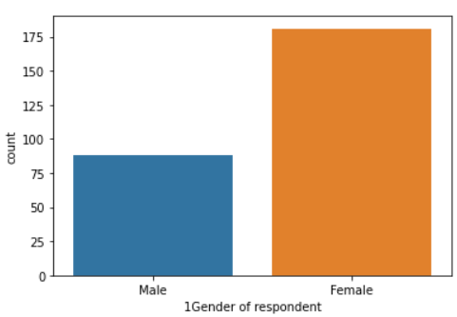
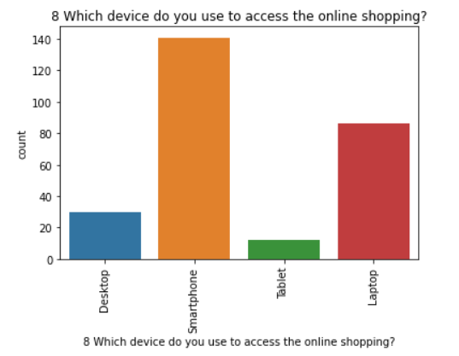
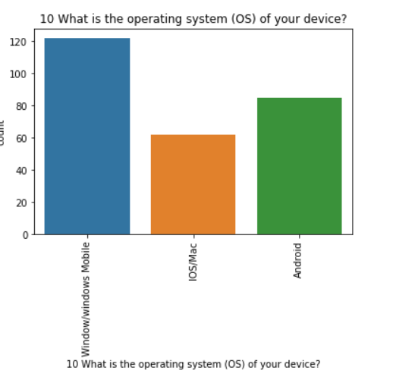
Graphical Visualization :
Univariate Analysis :

Slide 12
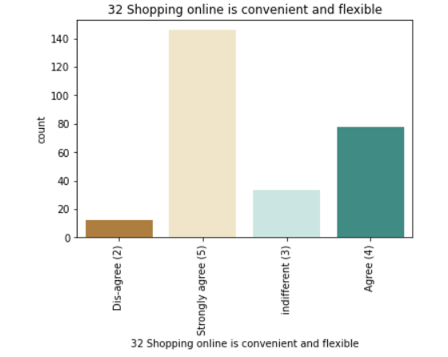
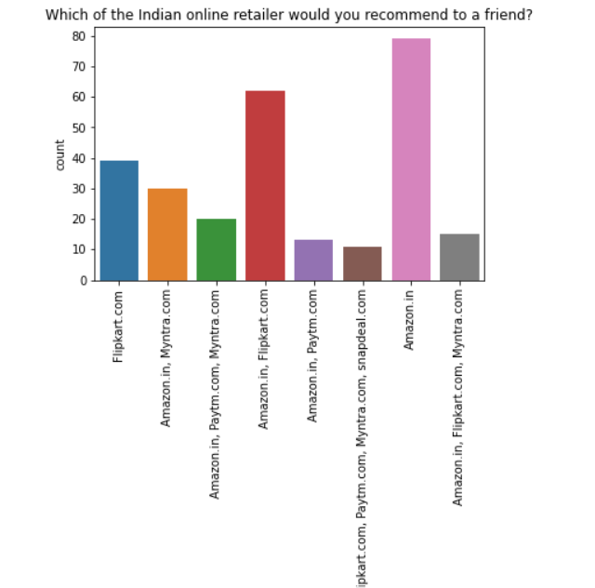
Univariate Analysis :

Slide 13
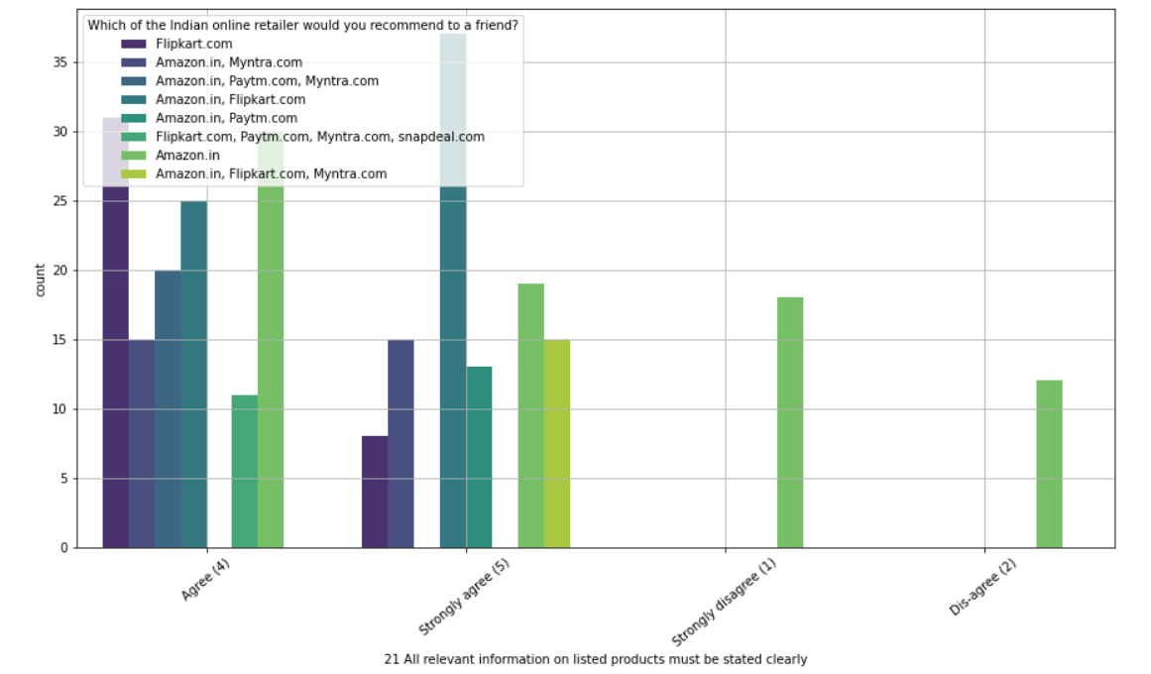
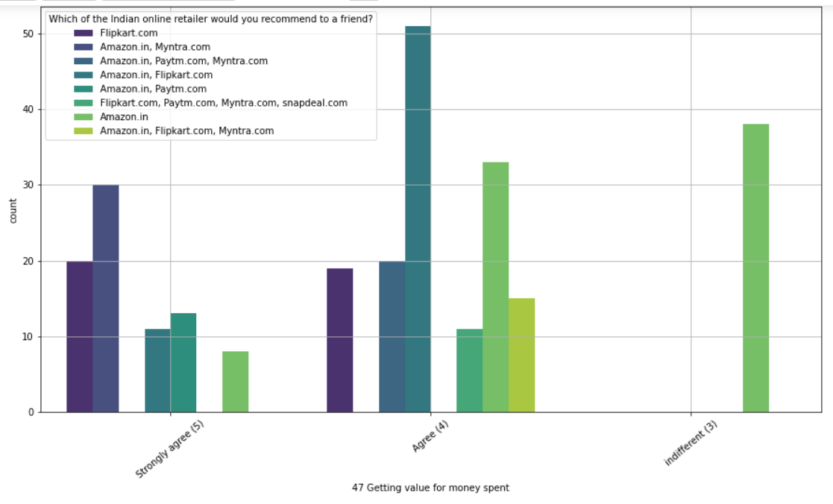
Bivariate Analysis :

Slide 14
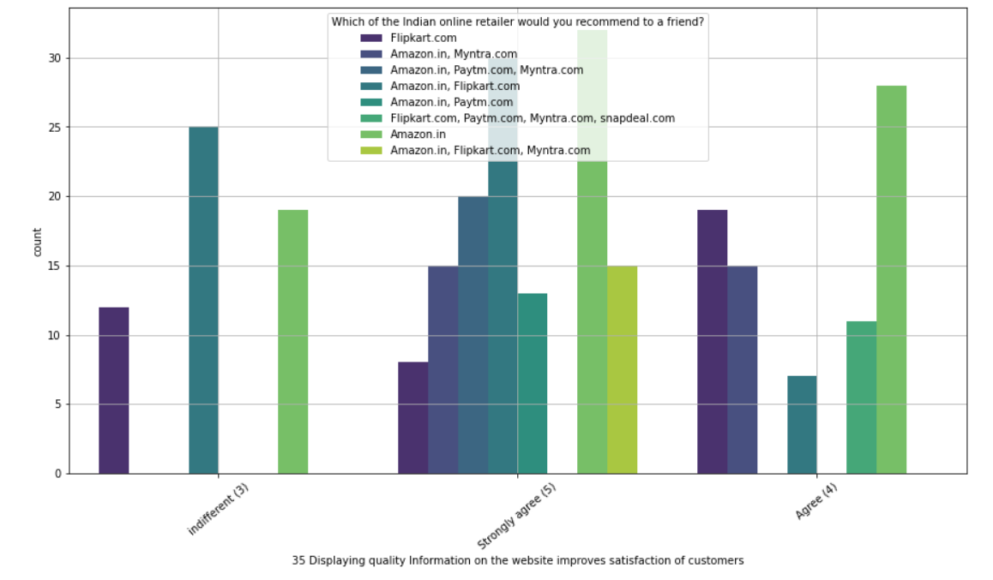
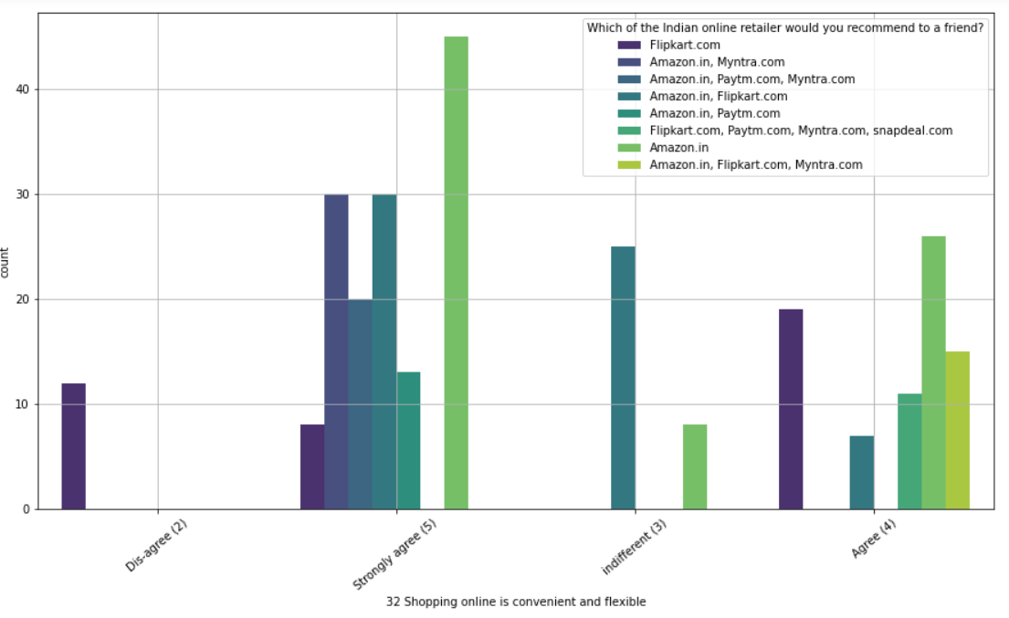
BIVARIATE ANALYSIS :

Slide 15
Assumptions :
Initially we assumed that customers recommend e-commerce websites to their friends, if they are satisfied with the service and they are frequently using the websites for online shopping.
In order to prove that the customer expectations on a e-commerce website should influence the websites they recommend to their friends.
This implies that the websites recommended to their friends should meet the customer expectation and it is highly likely to be re-visited by the buyers for future purchases.
This hypothesis proves that the buyer who recommends a e-commerce site to a friend is the retained buyer of the respective e-commerce companies.

Slide 16
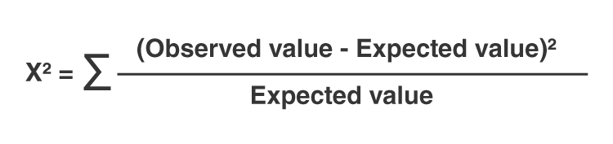
Here in order to prove the correlation between the customer expectation and the website recommendation to a friend, we have used chi-squared test
The alpha value assumed was 0.05 (5%) and we have to find the p-value for each customer expectation variables
Null Hypothesis (Ho) was that the customer expectation variable has no relation with the website recommendation to a friend (p > alpha)
Alternate Hypothesis (Ha) was that the customer expectation variable influences the website recommendation to a friend (p < alpha)

Slide 17
Limitations And Scope for the Future :
The data used to analyse the customer retention was very less
The answers towards the e-commerce sites were combination of two or more e-commerce sites, the survey answers should have been limited to maximum 2 websites in order to understand the retention rates better.
It would have been beneficial to include a question asking that “ Which website would you purchase from again?”

Slide 18
Conclusion :
As per our analysis, I can say that the companies with highest retention and customer satisfaction rates are Amazon.in and Flipkart.com because their positives are line with the buyer preferences and they are most likely to use these websites for purchases in future.
The company with moderate retention rate is Myntra.com Further, the company with very low retention rate and customer satisfaction is with Paytm and Snapdeal because most of the factors are not in line with the customer preferences and they are less likely to use this website again for online purchases.
Customer satisfaction plays a major role in retention, A company should first understand what customers expects while purchasing online (e-commerce) and build a better buying experience which will in turn retain the customer. An unforgettable experience is what drivers customers to buy again and again.

Slide 19
The main factors that drives customer satisfaction are.
Easy to read and understandable content
Relevant information on all the products
Easier website design and navigation
User friendly Interface
Convenience in payment methods
Trust and On time delivery.
Better Customer Service
Secure and offers complete privacy to their customers
Discounts and Monetary Benefits
Wide range of options and product selections
Flexibility in their offers and services
Return and Replacement policies
Quality information on websites
Website Quality
Value for the money spent

Slide 20

Submitted By :- Haindavi Chakravarthi
Internship :- 23

